Slide 1
Initial Expedition Training Learning Outcome 1 Route Planning
Uncontrolled copy not subject to amendment
Version 2.0 OCT 2014

Slide 2
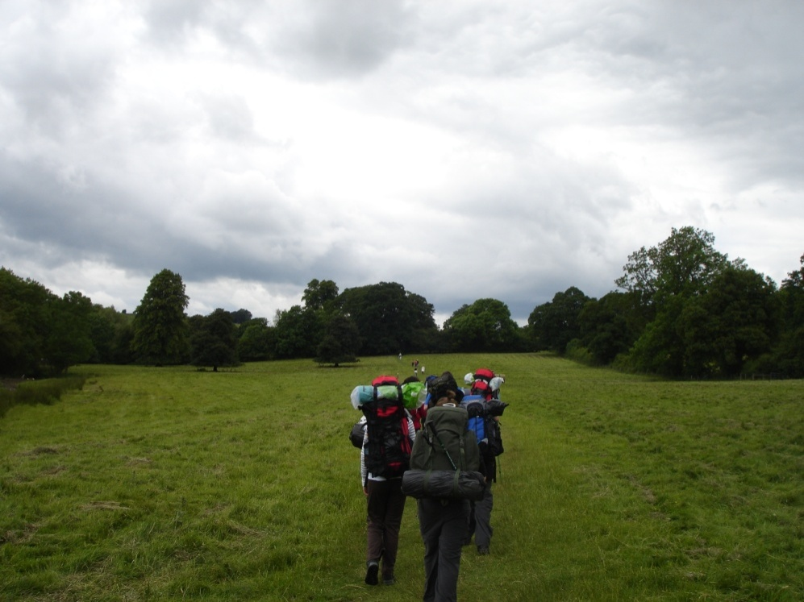
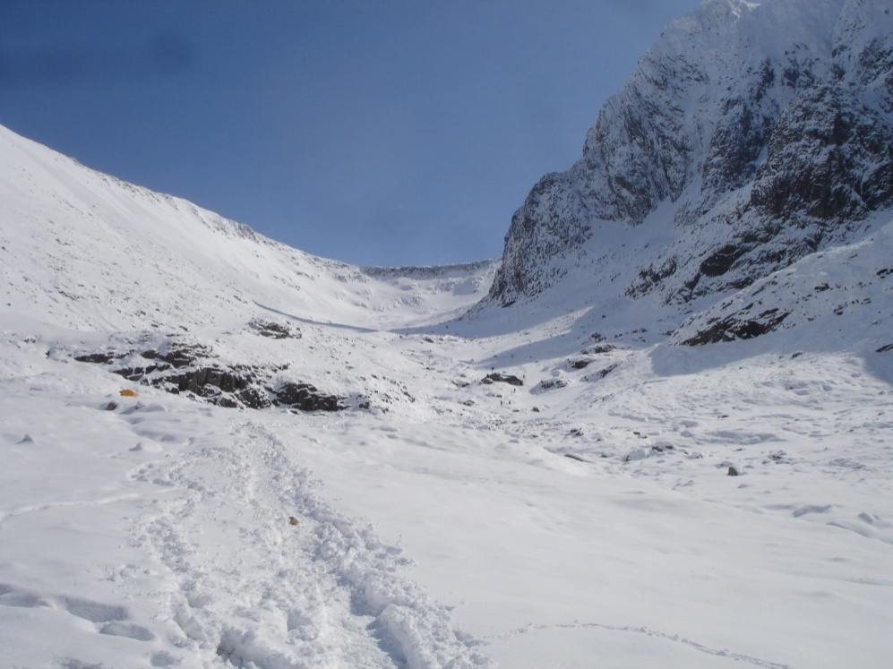
The group and the ground
Cotswolds in Summer
West edge of Ben Nevis under snow
Which trip are you ready for?

Slide 3
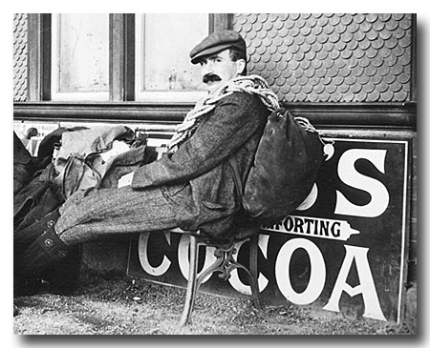
Naismith’s Rule
William Wilson Naismith (1856 - September 27, 1935)

Slide 4
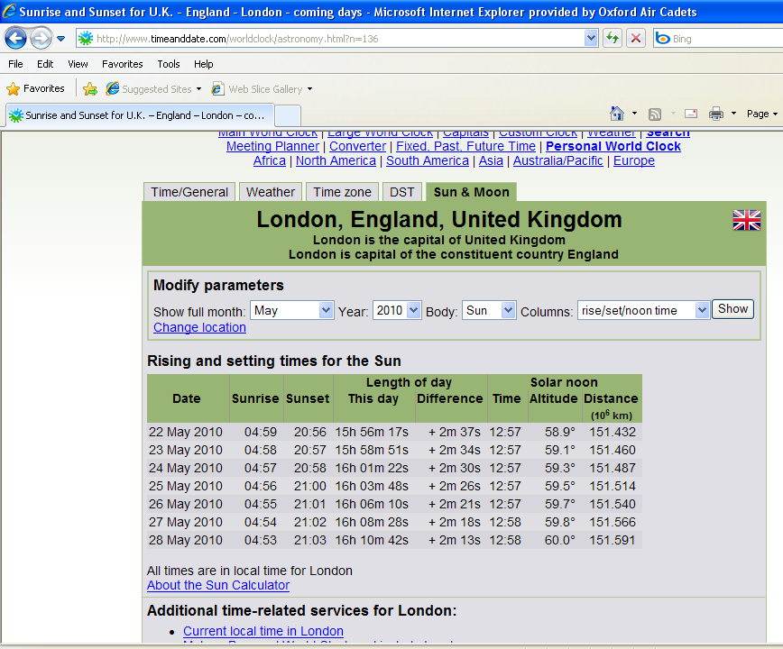
Time of darkness

Slide 5
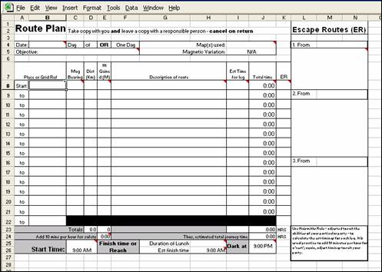
Route planning
Three needed: one for the team, one for the supervisor and one for assessor

